Slide 1


Slide 2
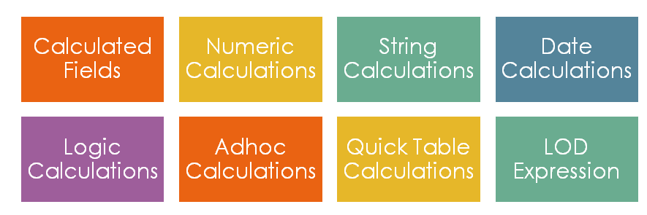

Slide 3
What are Calculated Fields
In the tableau, columns in the dataset (or database) are known as fields.
where Calculated Field is a field (or columns) that uses the fields of the given dataset and applies additional logic- it allows the creation of a new field from the given dataset.
Calculated field either:
Do some calculations on the given fields of the dataset to create a value that is not present in the dataset.
Select values from the dataset based on the user-defined criteria.

Slide 4
Note:
The new calculated field is saved to your data source in Tableau and can be used the same way as the other fields in the data source.
The original fields in the dataset remain unchanged.
Some common scenarios where calculated fields are used in Tableau:
The data you need for analysis is missing in the given dataset .
Want to transform values in the visualization
Want to categorize data quickly

Slide 5
Tableau has lot of inbuilt functions that help in creating expressions for complex calculations.
Arithmetic/Number Functions
String Functions
Date Functions
Logical Functions
Type conversion Functions
Note: All the calculated fields have an equal sign (=) next to them in the Data Pane.

Slide 6
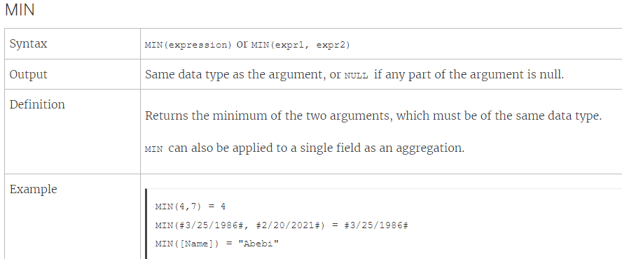
Arithmetic Calculations:
Number functions allow you to perform computations on the data values in your fields.
ABS (Number)
DIV(integer1, integer2)

Slide 7
Create a number calculation
Analysis > Create Calculated Field.
In the calculation editor that opens, do the following:
Name the calculated field Minimum Sales transaction
Enter the following formula:
MIN[Sales]
When finished, click OK.
The new number calculation appears under Measures in the Data pane. Just like your other fields, you can use it in one or more visualizations.
When Minimum Sales is placed on Text on the Marks card in the worksheet, its name is changed to AGG(Minimum Sales), which indicates that it cannot be aggregated any further, since it is already aggregated down to the lowest level of detail (the smallest sales value for all records).

Slide 8
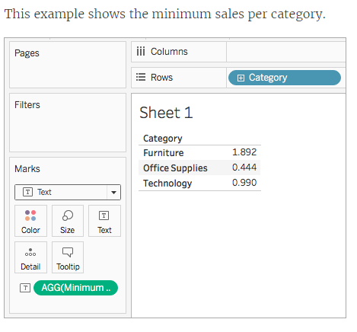
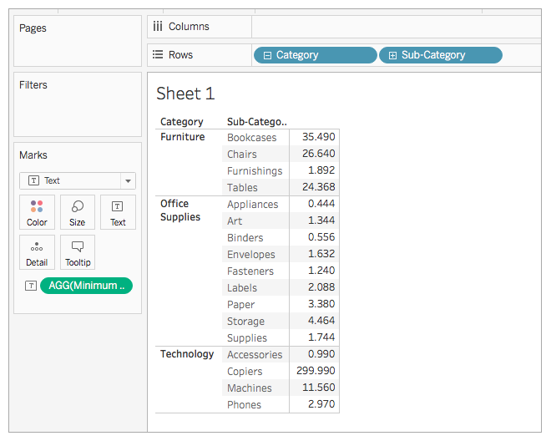
the minimum sales for each subcategory

Slide 9
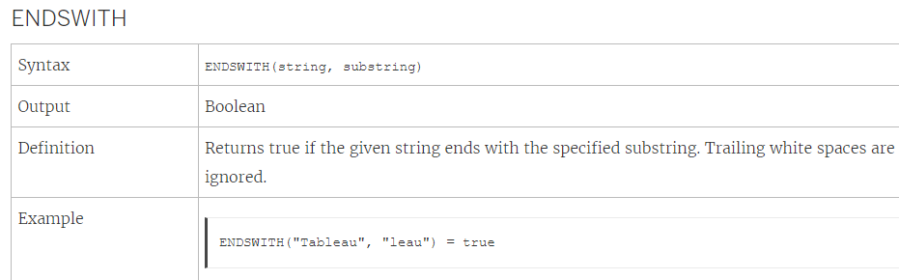
String Functions : String functions allow you to manipulate string data (i.e. data made of text).
1. CONTAINS
Syntax | CONTAINS(string, substring)
Output | Boolean
Definition | Returns true if the given string contains the specified substring.
Ex: CONTAINS("Calculation", "alcu") = true

Slide 10
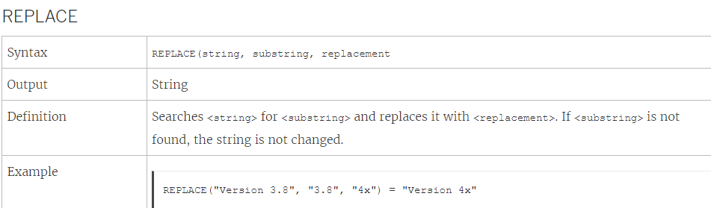
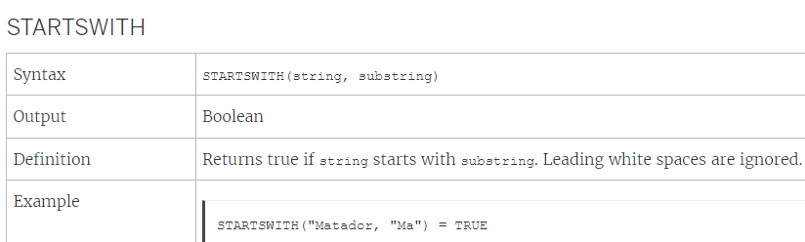
Max
Min

Slide 11
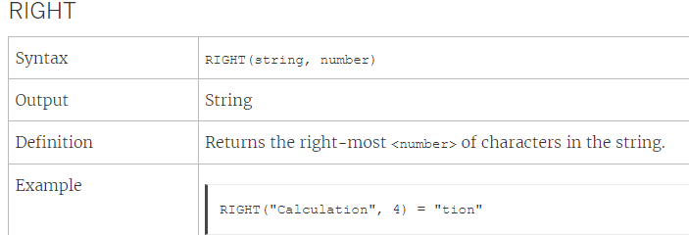

Slide 12
Create a string calculation
From the Data pane, under Dimensions, drag Order ID to the Rows shelf.
Notice that every order ID contains values for country (CA and US, for example), year (2011), and order number (100006).
For this example, you will create a calculation to pull only the order number from the field.
Select Analysis > Create Calculated Field.
In the calculation editor that opens, do the following:
Name the calculated field Order ID Numbers.
Enter the following formula:
RIGHT([Order ID], 6)
This formula takes the specified digits (6) from the right of the string and pulls them into a new field.
Therefore, RIGHT('CA-2011-100006' , 6) = '100006'.
When finished, click OK.
The new calculated field appears under Dimensions in the Data pane.

Slide 13
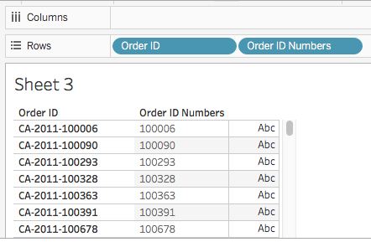
From the Data pane, drag Order ID Numbers to the Rows shelf. Place it to the right of Order ID.

Slide 14
Ex1:
Find out the profit coming from the customers whose first name is “Bryan”.

Slide 15
Date Functions:
DAY
Returns the day of the month (1-31) as an integer.
Syntax | DAY(date)
Output | Integer
Definition | Returns the day of the given <date> as an integer.
Example | Day(#September 22, 2018#) = 22
MONTH
Syntax | MONTH(date)
Output | Integer
Definition | Returns the month of the given <date> as an integer.
Example | MONTH(#1986-03-25#) = 3

Slide 16
Create a date calculation :
From the Data pane, under Dimensions, drag Order Date to the Rows shelf.
On the Rows shelf, click the plus icon (+) on the YEAR(Order Date) field. QUARTER(Order Date) is added to the Rows shelf and the view updates.
On the Rows shelf, click the plus icon (+) on the QUARTER(Order Date) field to drill down to MONTH(Order Date)
Select Analysis - > Create Calculated Field.
In the calculation editor that opens, do the following:
Name the calculated field, Quarter Date.
Enter the following formula: DATETRUNC('quarter', [Order Date])
When finished, click OK. The new date calculated field appears under Dimensions in the Data pane.
From the Data pane, under Dimensions, drag Quarter Date to the Rows shelf and place it to the right of MONTH(Order Date). The visualization updates with year values.
6. On the Rows shelf, right-click YEAR(Quarter Date) and select Exact Date.
7. On the Rows shelf, right-click YEAR(Quarter Date) again and select Discrete

Slide 17
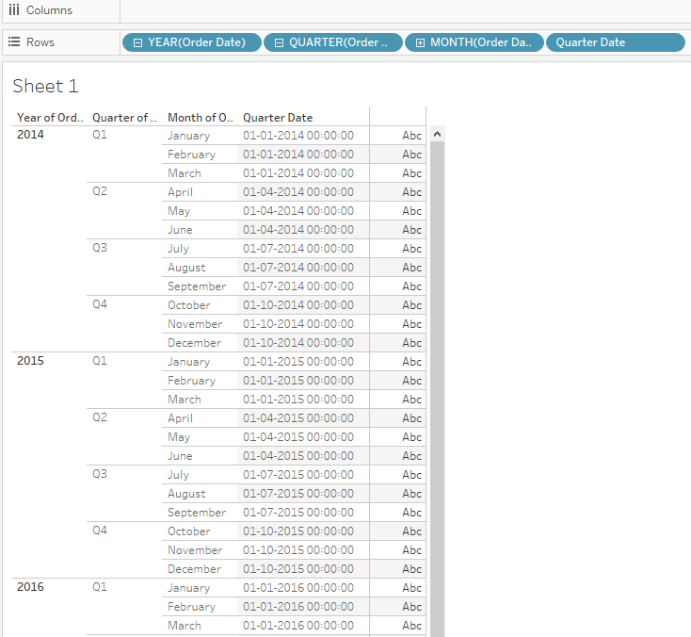

Slide 18
Ex2:
Find out the difference in order date and ship date to know the average no.of days taken to ship an order placed.

Slide 19
Type Conversion
Type conversion functions allow you to convert fields from one data type to another (this is called "casting"). For example, if you have date information in a field with a string data type, you won't be able to use that field in date calculations unless the field is cast (changed) to a date data type.
Ex: STR
Ex: 1. Select Analysis > Create Calculated Field.
In the calculation editor that opens, converts the Postal Code field from a number to a string:
Name the calculated field, Postal Code String.
Enter the following formula: STR([Postal Code])
When finished, click OK.
The new calculated field appears under Dimensions in the Data pane.
Converting this field from a number to a string ensures that Tableau treats it as a string and not a number (and therefore doesn't aggregate it)
Syntax | STR(expression)
Output | String
Definition | Casts its argument as a string.

Slide 20
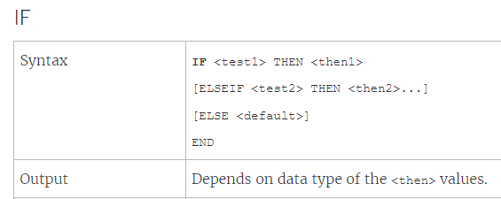
Logical Functions: Logical calculations allow you to determine if a certain condition is true or false.
Logical functions and operators available in Tableau
OR
1. And:
yntax | <expr1> AND <expr2>
Definition | Performs a logical conjunction on two expressions. (If both sides are true, the logical test returns true.)
Output | Boolean (true or false)

Slide 21
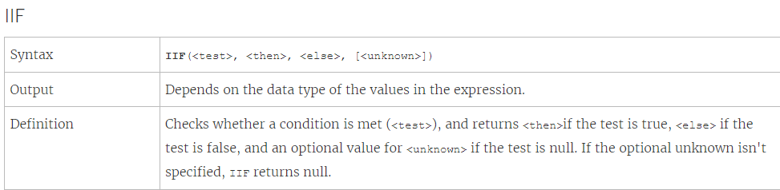
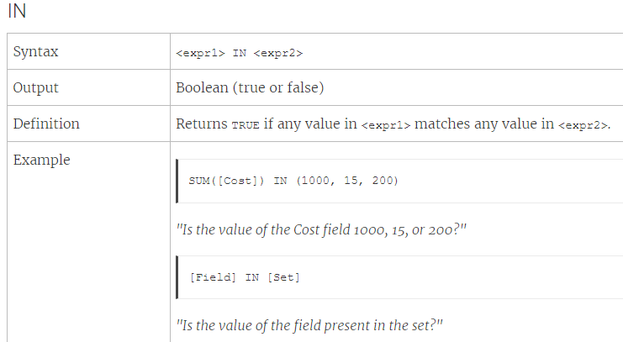

Slide 22
From the Data pane, drag State to the Rows shelf.
From the Data pane, drag Category to the Rows shelf and place it to the right of State.
From the Data pane, drag Sales to the Columns shelf.
Select Analysis > Create Calculated Field.
In the calculation editor that opens, do the following:
Name the calculated field KPI.
Enter the following formula: SUM([Profit]) > 0
This calculation quickly checks if a member is great than zero.
If so, it returns true; if not, it returns false.
When finished, click OK.
The new calculated field appears under Measures in the Data pane.
From the Data pane, drag KPI to Color on the Marks card.
You can now see which categories are losing money in each state.

Slide 23
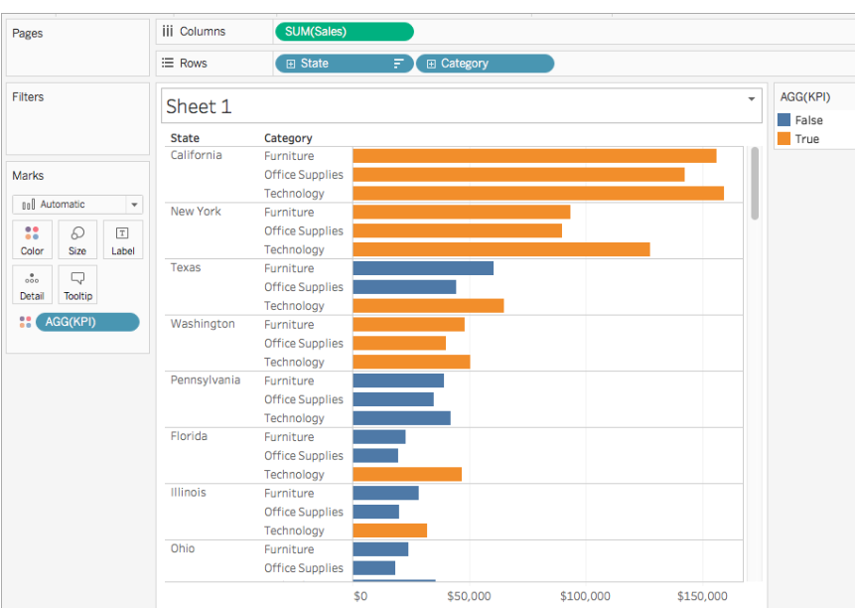

Slide 24
IF-ELSEIF- ELSE-END logical function
Ex3: Create a calculated field to categorized sales into different groups “High Sales”, “Moderate sales” and “Lower Sales”
IF SUM([Sales])>200000 THEN "high sales"
ELSEIF SUM([Sales])<50000 THEN "Low sales"
ELSE "moderate sales"
END

Slide 25
Problem Statement: Calculate Profit Sale Ratio of products
subcategories within different states.

Slide 26
Problem Statement: Calculate Profit Sale Ratio of products subcategories within different states.
Steps to Create Calculated Fields:
Drag and Drop State into the column shelf
Drag and Drop Category and Sub-Category into the row shelf.
Create Calculated Field
Select Analysis -> Select Create Calculated Field
Enter the name Profit-Sale Ratio
Enter the Formula
IIF ([Sales]!=0,[Profit]/[Sales],0)
Note: The above formula:
Checks Sales is not equal to zero
If True, return Profit ratio ([Profit]/[Sales])
If False returns 0
Click OK
New Calculated Field Profit-Sale Ratio is added in the Data Pane
Drag and Drop Profit-Sale Ratio on the Mark Card

Slide 27
Query 1: Using the sample superstore data, find what percent of East region sales came from “consumer” segment in the year 2017?
2: Find which product is ranked 6th in sales for west region?
3. Compute the % growth in sales between June 2015 and June 2017

